Slide 1
LISTENING

Slide 2
Listening skills
01
02
03
04
Predicting
Listening for Main ideas
Listening for Details
Making Inferences

Slide 3
Listening skills
05
06
07
Recognizing synonyms/ paraphrasing
Recognizing distractors
Understanding connected speech

Slide 4
01. Predicting
Read the title, headings, pictures, etc. → to predict information in the text
Read the questions → predict the answers
type of information (E.g.: name, date, number, price, etc.)
type of words (E.g.: nouns, verb, adjective, etc.)
synonyms/ paraphrasing (E.g.: 25% = a quarter)
→ help to understand the audio
→ identify the right information

Slide 5
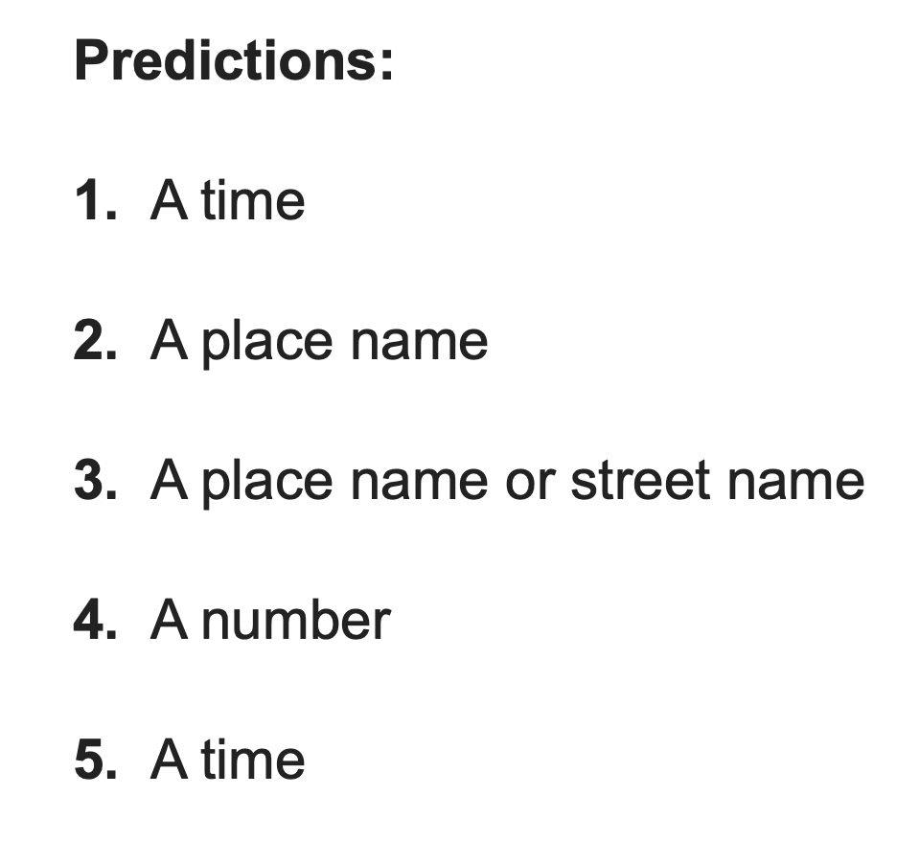
Practice

Slide 6
02. Listening for Main ideas
Main idea = what the speaker is trying to say
= “big picture” = covers the ideas of the listening text
Main idea is often repeated to emphasize the key point
Keys to identify Main ideas:
discourse markers:
E.g.: The main point is .../What I’m trying to show is …/What I’m going to talk about today is …..
Repetition (how many times the word/phrase is repeated)
Pace: + unimportant points → usually spoken quickly + important information points → usually spoken slowly and clearly
Visual aids (outlines, lists, drawings, etc.) → provide clues to the main point

Slide 7
Practice
You will listen to an audio and find out what is the speaker talking about.
Audio:
https://drive.google.com/file/d/1i6hqxGHVLbr5Gta2md_SaTLudkGzVjtY/view?usp=sharing

Slide 8
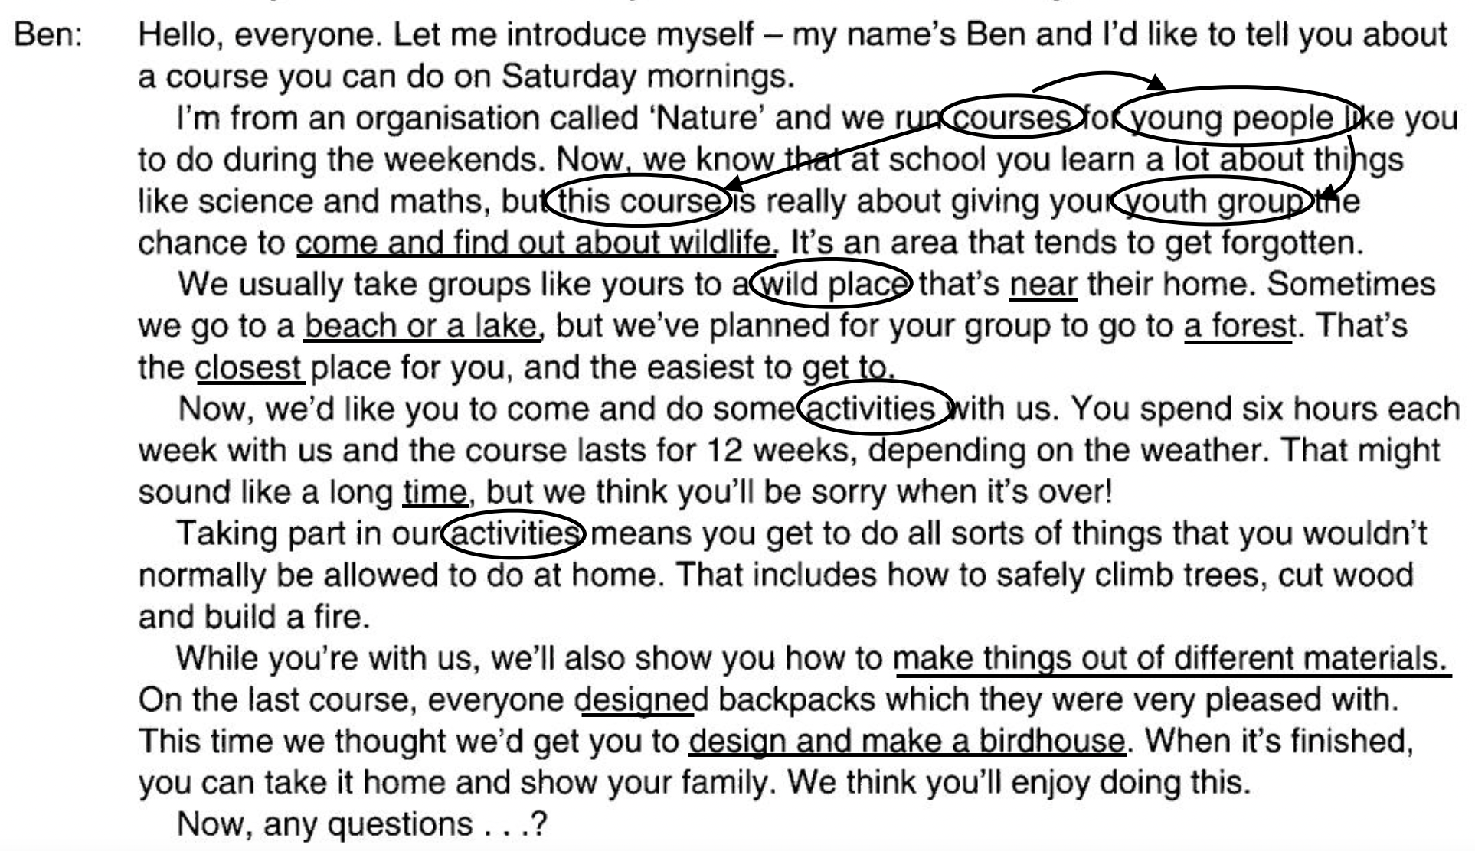
Tapescript
The main ideas of the listening text is that Ben introduced the course for young people in terms of the place where it is planned and the activities will be included.

Slide 9
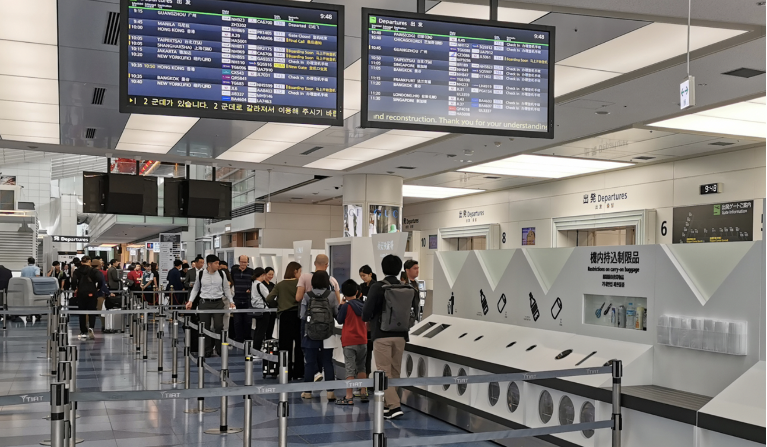
03. Listening for Details
Details = facts, statements, examples, etc.
not need to understand the meaning of every word or the whole listening text.
pick up the information and answer the question.
E.g.: Listen to the announcement at the airport
to find out the time of your flight.

Slide 10
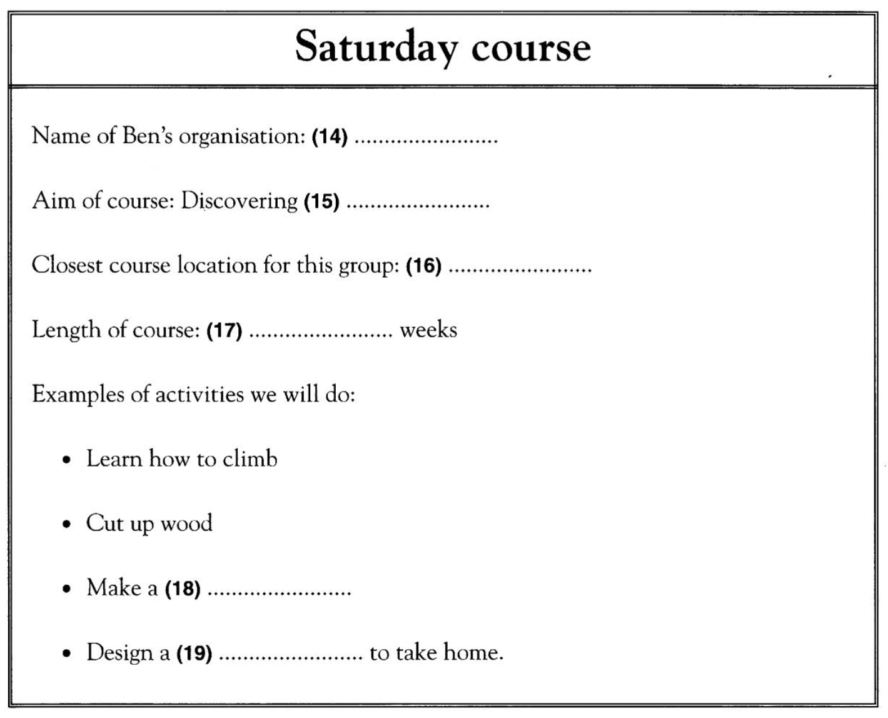
Practice
You will hear a man called Ben, from a young people’s organization telling to a youth group about a course they can do on Saturdays.
Audio:
https://drive.google.com/file/d/1i6hqxGHVLbr5Gta2md_SaTLudkGzVjtY/view?usp=sharing

Slide 11
Tapescript
KEYS

Slide 12
04. Making inferences
understand what the speakers are saying by inferring meaning, as the information is not always explicitly stated.
infer the speaker’s attitude to what they are saying, their purpose and the reasons specific information is mentioned.
To infer meaning, you need to listen for clues in the text (e.g.: relationship between the speakers, tone of voice, word use, etc.) and use your general knowledge to guess the meaning of what the speakers are saying.
Notes:
In the listening section, there are times when you will need to understand what the speakers are saying by inferring meaning, as the information is not always explicitly stated.

Slide 13
Practice
Listen to the audio and then select the correct answer:
Audio: https://drive.google.com/file/d/1VOivqqrjcBFw7n8sbA0wtonVGGV_rqEk/view?usp=sharing
Question 1: What did she buy? A. Belt B. Scarf C. Shoes D. Gloves
Tapescript: I just bought the perfect accessory for my outfit. It's gray and made of cashmere. It's very soft and it will keep my neck warm during the winter. I have a few others made of silk and cotton, but this one looks great with my navy jacket.

Slide 14
Practice
Listen to the audio and then select the correct answer:
Question 2: What season is he talking about? A. Spring B. Summer C. Fall D. Winter
Tapescript: I love this time of the year. The leaves are changing colors. There are so many on the ground. My son likes to pile them up and jump in them. We also like to carve pumpkins and display them outside. After hot days of summer, I look forward to some cooler months.

Slide 15
Practice
Listen to the audio and then select the correct answer:
Question 3: What is the woman talking about? A. Getting married B. Getting divorced C. Her deceased spouse D. Having more children
Tapescript: We are just not happy together anymore. We tried marriage counseling, but that didn't help us. The kids are going to be devastated, but we cannot pretend to be happy anymore. We will have joint custody of the children. I will have the kids during the weekdays and my husband will have them during the weekends.

Slide 16
Practice
Listen to the audio and then select the correct answer:
Question 4: What is the man looking forward to? A. High school graduation B. College graduation C. Retirement D. Getting married
Tapescript: It's been a difficult four years, but I'm finally done. I changed my major three times. I thought I wanted to become a doctor, but I realized I'm not interested in medicine. The courses were hard and not interesting to me. I already have my first interview for a computer programmer job next week. I am looking forward to receiving my diploma tomorrow.

Slide 17
Practice
Listen to the audio and then select the correct answer:
Question 5: What is the woman talking about? A. She's giving directions to her house B. She's reading a recipe C. She's teaching someone how to drive D. She's helping her son with his geography homework
Tapescript: Make a left turn at the stop sign. Travel on Main Street for 3 miles. When you reach First Avenue, make a right turn. My house is on the left side of the road. It is red with white trim. You will see a black car in the driveway. The house number is 13579.

Slide 18
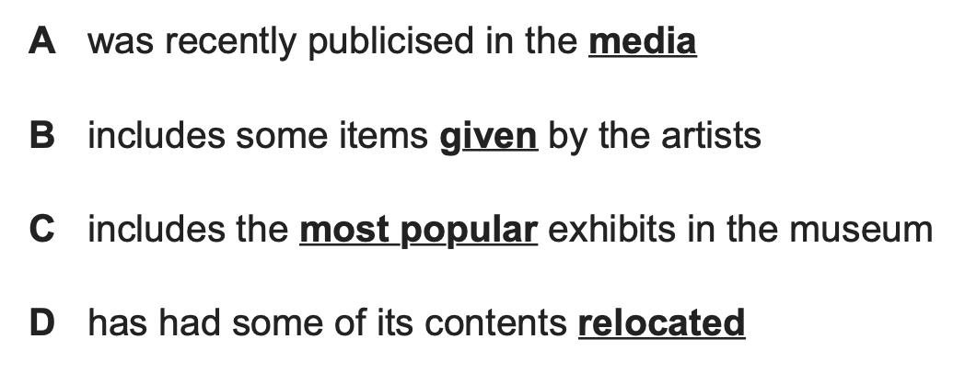
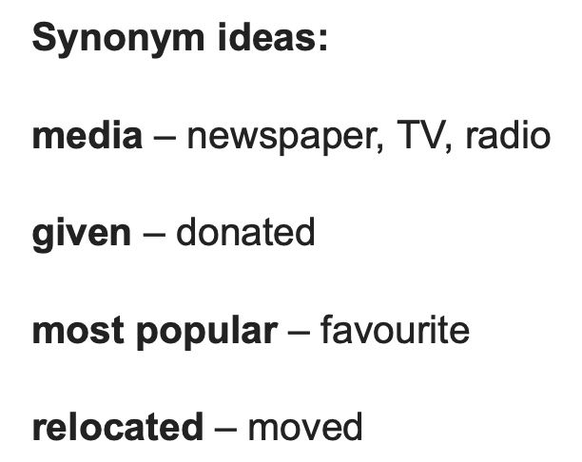
05. Recognizing synonyms/ paraphrasing
underline the keywords:
+ do not expect to hear the same vocabulary
+ but hear the synonym or paraphrasing of the key words
Practice
Find the synonyms/ paraphrasing of the words below

Slide 19
- synonym
- paraphrasing structure
- synonyms
- synonym
- word form change
- synonym
- paraphrasing structure

Slide 20
06. Recognizing distractors
Distractors = words and phrases used by speaker
→ qualify something or to correct themselves or another speaker
- If you do not listen carefully, you will misunderstand and choose the incorrect answer.

Slide 21
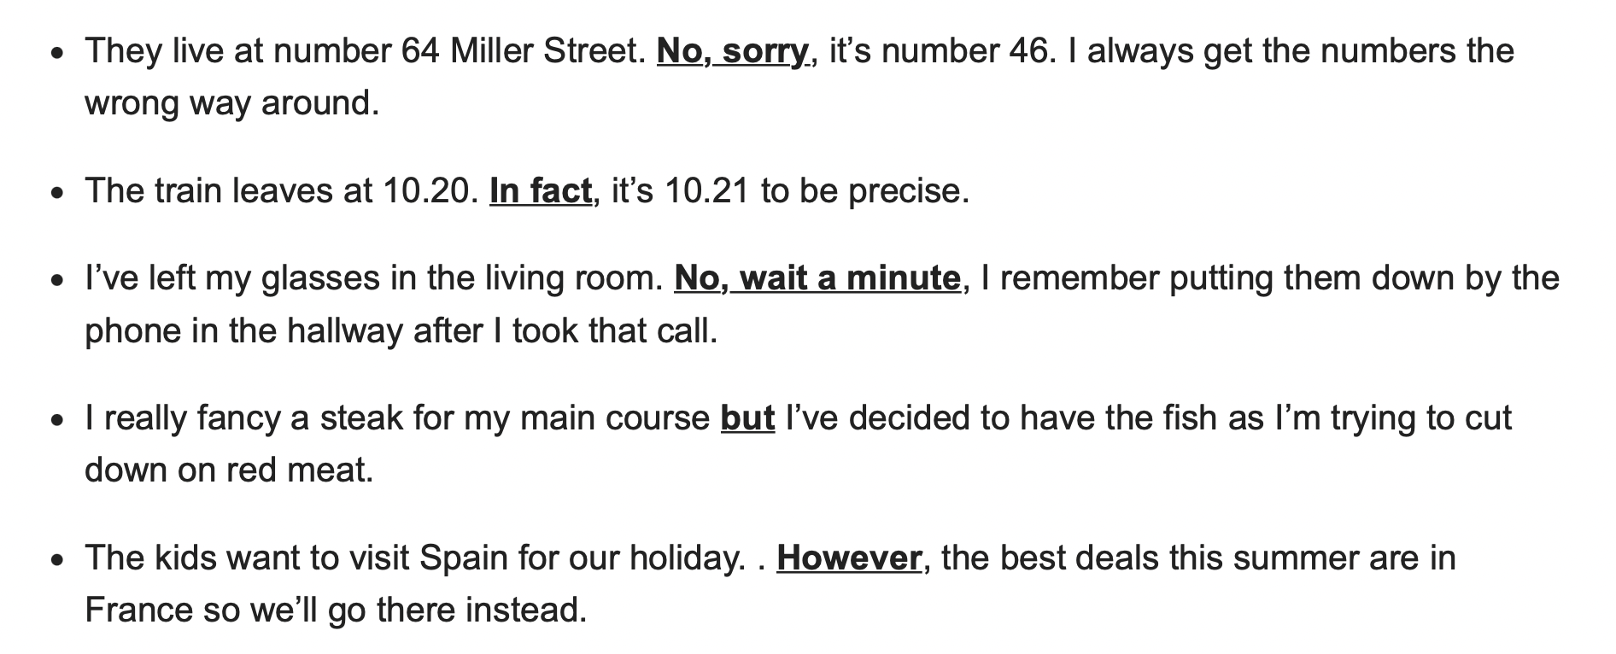
Example

Slide 22
07. Understanding connected speech
- Connected speech: when the words and sounds in a sentence run into each other → become difficult to understand
- If you do not listen carefully, you will misunderstand and choose the incorrect answer.
Example:
“hang out” → “hangout”
“clean up” → “cleanup”
“do it” → “dewit”
“don’t you” → “don-chu”
“meet you” → “mee-chu”
Practice
https://helenslanguagehome.com/my-language-blog/english-connected-speech-listening-exercises/#1517310363862-7e69868d-d1bf

