Slide 1
READING

Slide 2
Reading skills
01
02
03
04
Predicting
Skimming
(Reading for Main Ideas)
Scanning
Making Inferences
(Reading for Details)

Slide 3
Reading Questions
Multiple choice (A, B, C…)
True/ False/ (Not Given) - Yes/ No/ (Not Given)
Matching (names, headings, endings/ information, etc.)
Completion ( sentences, summary, tables, charts, notes, etc.)
Short answer

Slide 4
Basic steps to complete a reading task
Step 1
Step 2
Step 3
Read the questions
underline key words
Read the title, headings, pictures, etc.
→ to predict information in the text
Identify key words (or paraphrase of key words)
Reading the information carefully (make inferences if any)
Choose the correct answer

Slide 5
Key words
Type 1
Type 2
can not be changed
E.g.: names, terms, numbers, etc.
can be changed/ paraphrased
E.g.: nouns, verbs, adjectives, etc.
E.g.: Pasteur is famous for ….. a process to make milk safe for consumption.
Type 1. Type 2. Type 2. Type 2. Type 2

Slide 6
How to paraphrase
1. Synonyms
More than half of the people who attended BC’s seminar thought it was great.
-> The majority of the people who went to BC’s seminar thought it was amazing
2. Word form change
Watching a movie may help people to feel excited and satisfied.
-> Watching a movie may help people to feel excited and achieve a sense of satisfaction.
3. Passive voice
People say that overpopulation is caused by poverty
-> Overpopulation is said to be caused by poverty

Slide 7
quotes,

Slide 8
predict the text will be about?
why the picture is included?

Slide 9
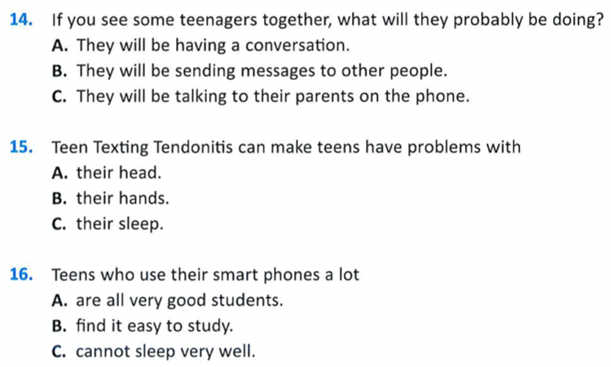
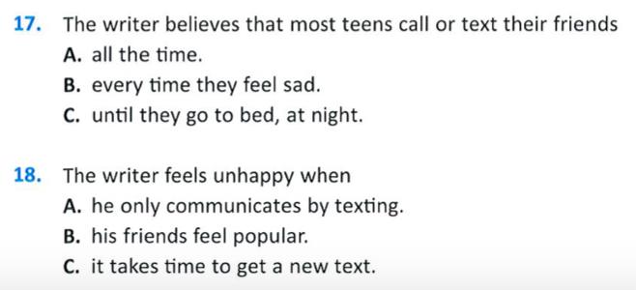

Slide 10
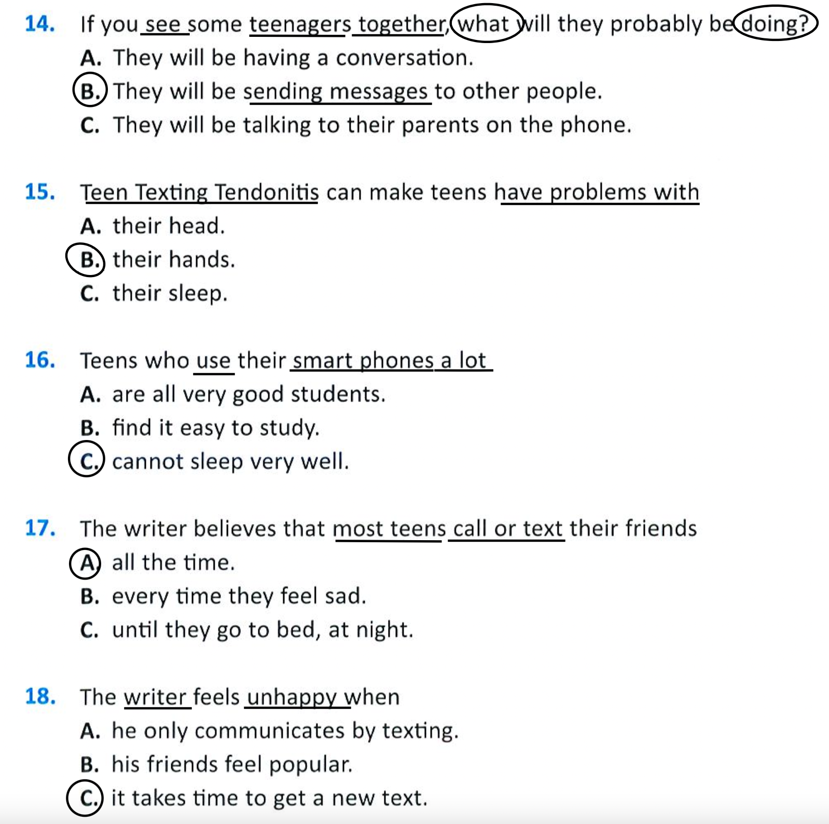
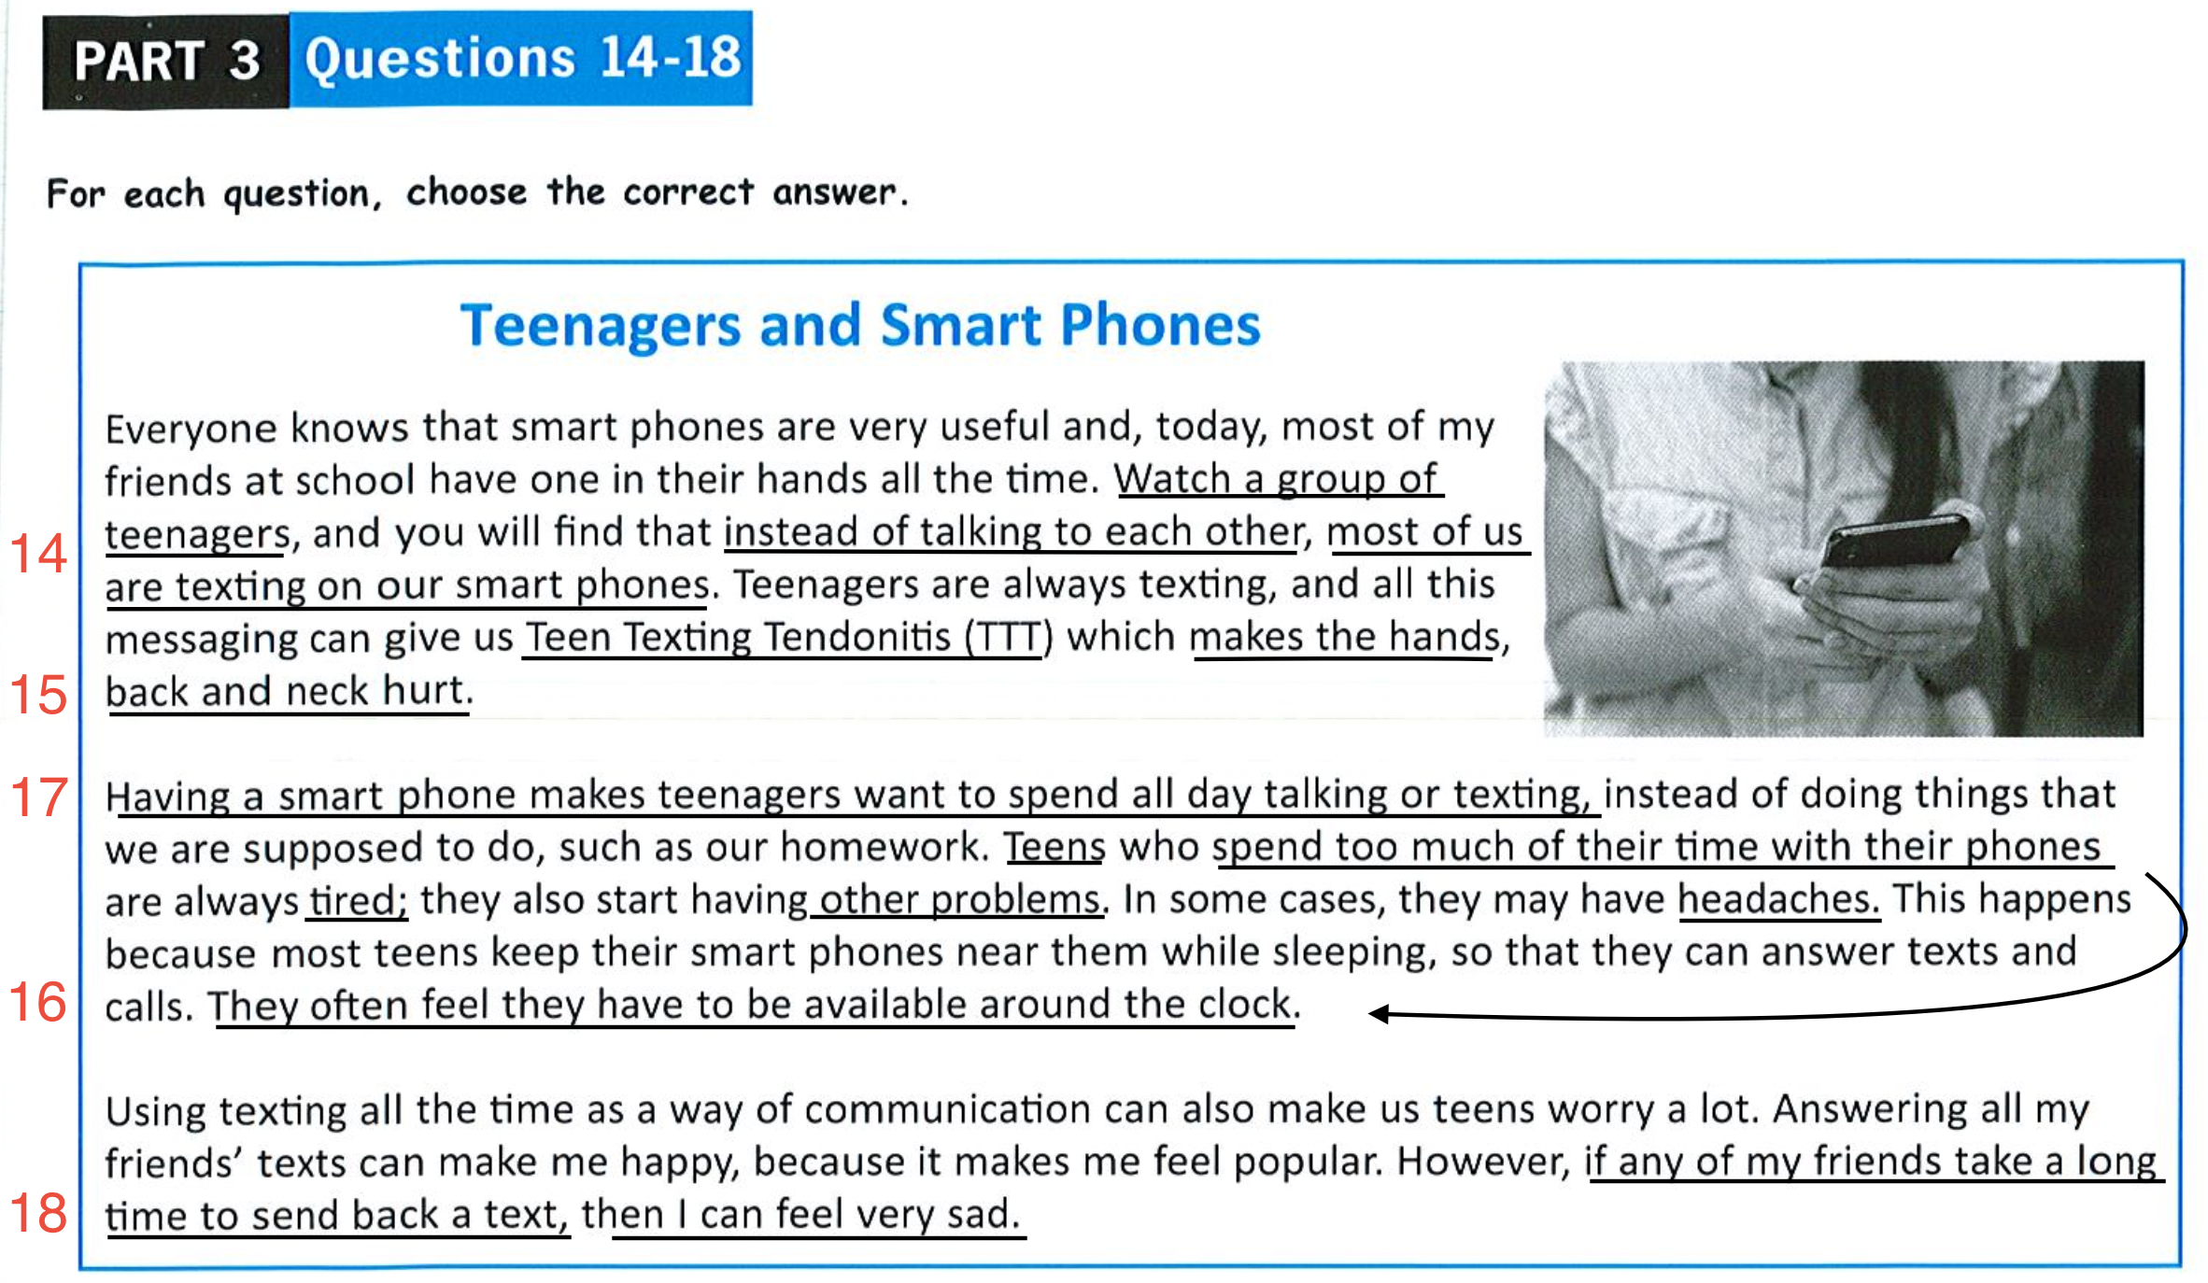

Slide 12
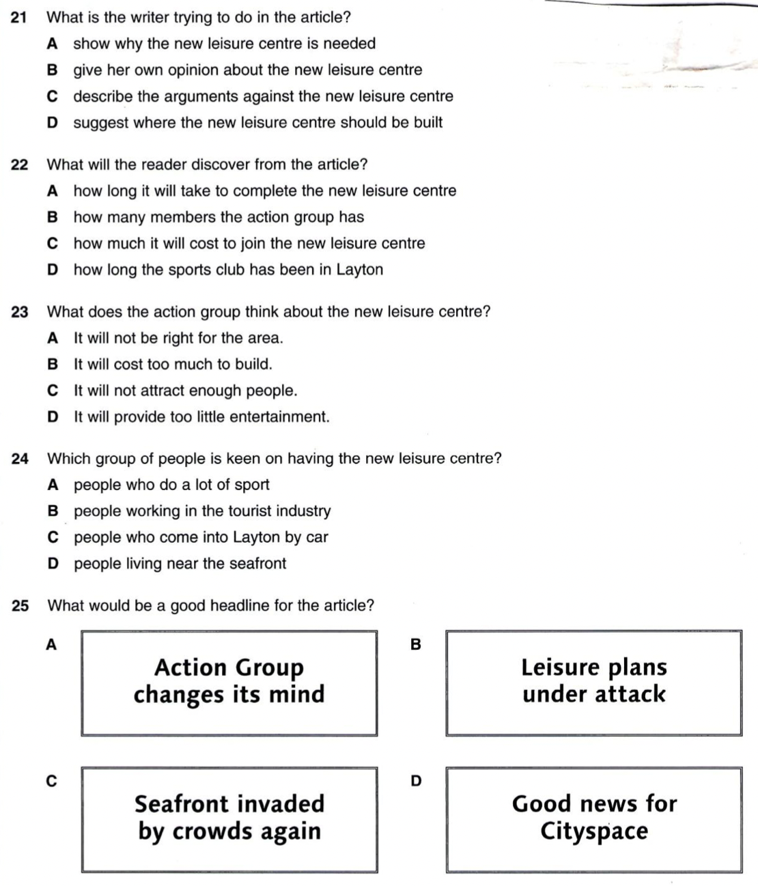
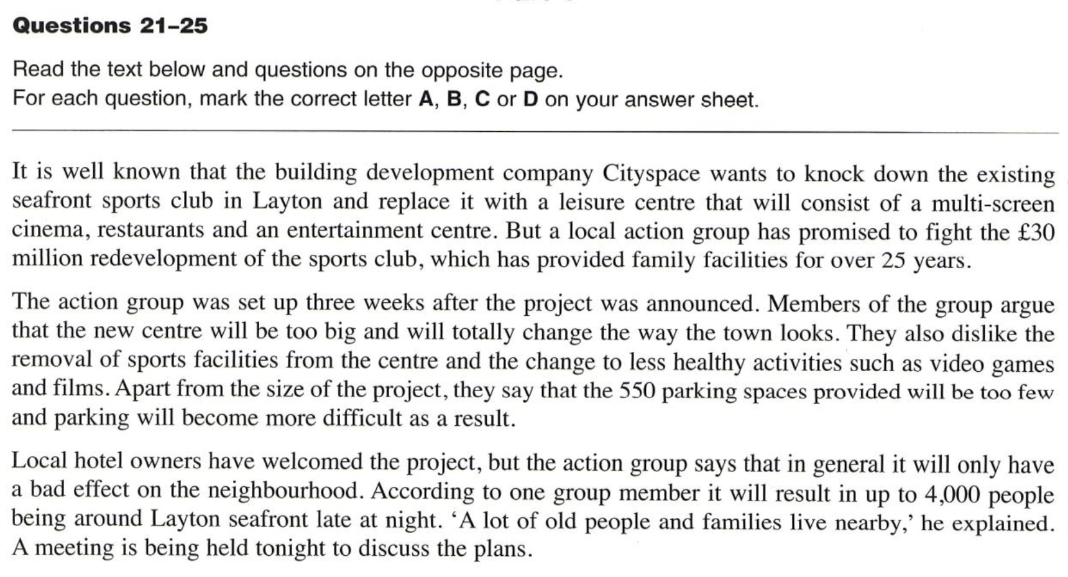
Practice

Slide 13
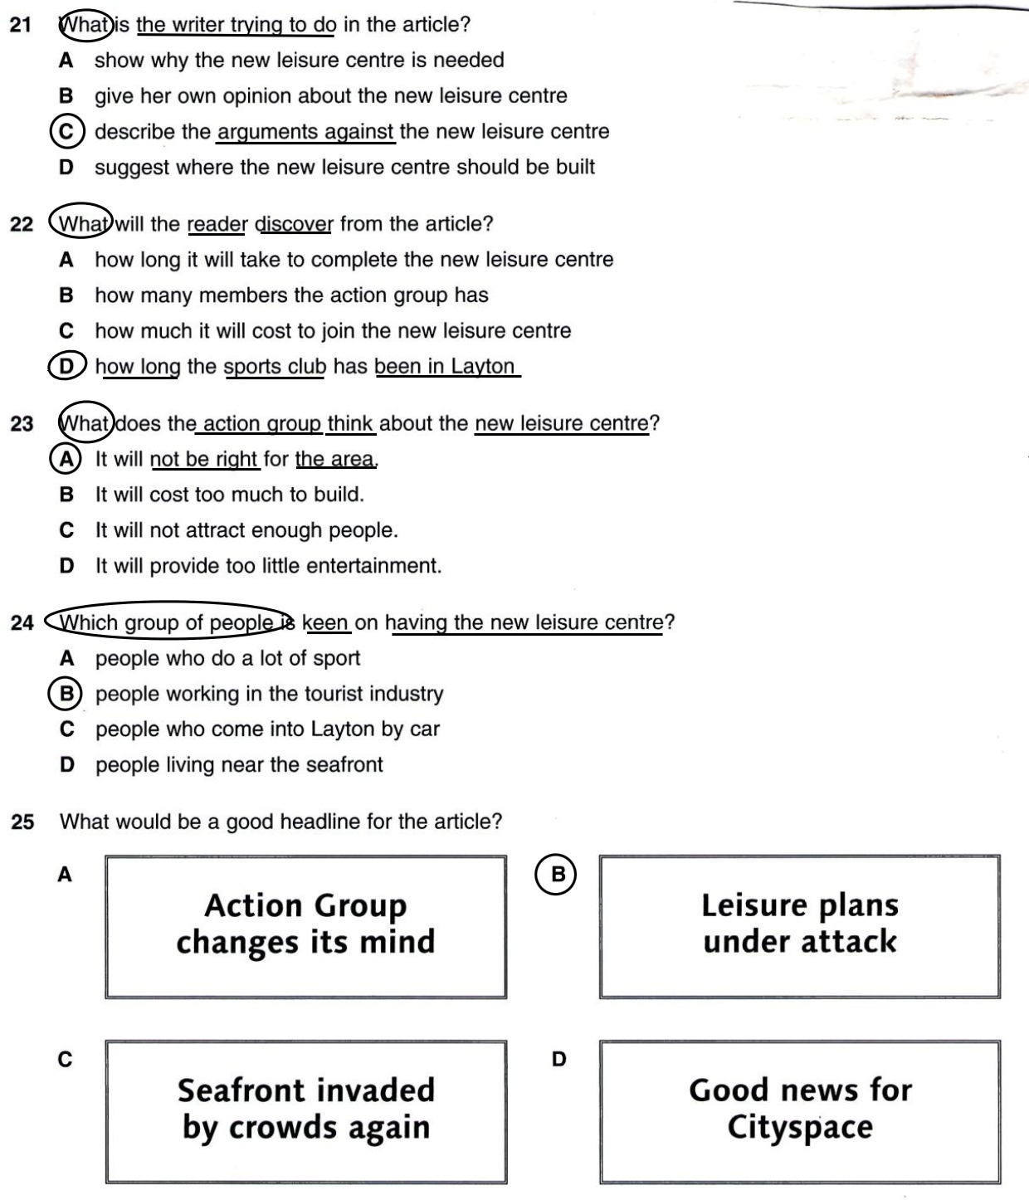
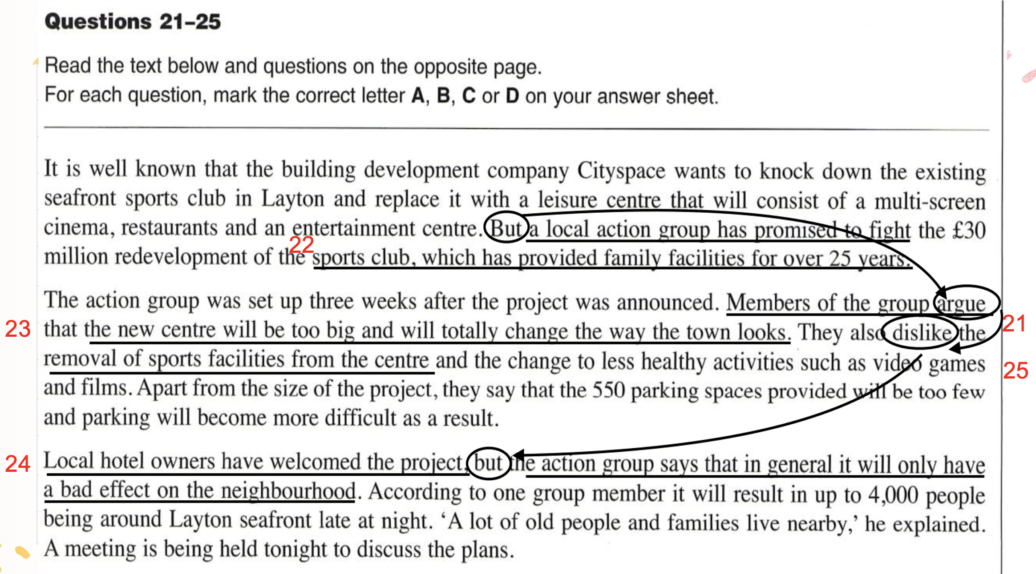
Practice

