Slide 1
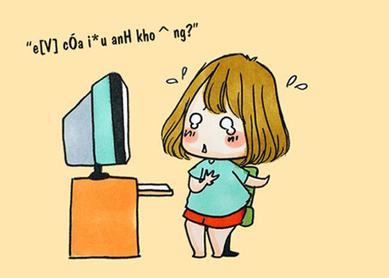
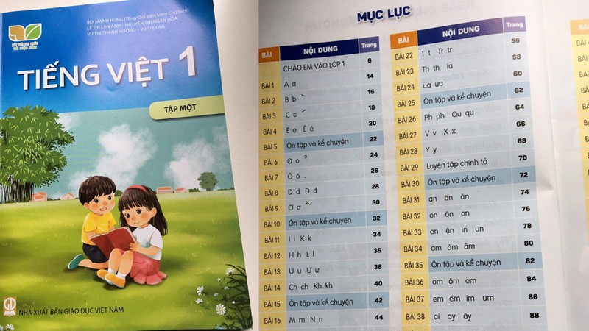
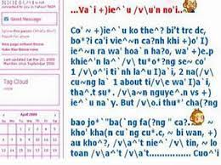
LEAD-IN

Slide 2
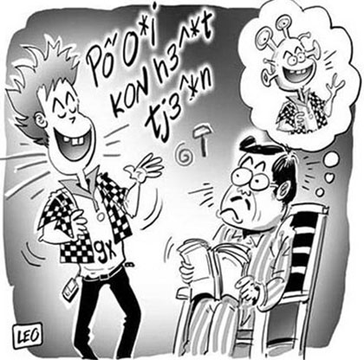
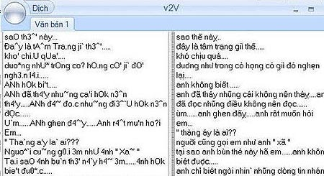
LEAD-IN
1. What do you think the people are talking about? What language do you think they are speaking?
2 What do you think an endangered language is? Why do you think people stop speaking a language?
3. Do you speak the same language as your parents? As your grandparents? Why or why not?

Slide 3
UNIT 8. ENDANGERED LANGUAGES
MSc. DƯƠNG THỊ HỒNG PHÚC

Slide 4
Objectives
Knowledge:
- List some words relating to cultures and languages
- Synonyms
- Expressions of predictions
Skills:
- Improve language skills: speaking and listening,
- use synonyms
- Express opinions
- Agree and disagree the opinion
- Deal with problems
Attitude:
- Be active, excited and enthusiastic in learning.
- Build a habit of using English in their careers.

Slide 5
1. VOCABULARY
1. LINGUISTS
2. NATIVE LANGUAGE
3. SECOND LANGUAGE
4. OFFICE LANGUAGE
5. BILINGUAL
6. PRESERVE
7. DISAPPEAR

Slide 6
2. CREATE
Situation 1
Student A, you are a parent. Your native language is endangered. You want your child to learn your native language at school, but the school only teaches English. You want the school to teach your native language.
Student B, you are the school's principal. You think all of the children should learn English at school because it is the dominant language in your community.
Situation 2
Student A, you are a parent. Your native language is endangered. You want your child to go to a community program to learn your native language, but your child does not want to go.
Student B, you are the child. You only want to learn English because all the children at your school speak it. You do not want to go to a community program

Slide 7
3. SPEAKING SKILL
Use will or be going to to state facts about the future make predictions about the future: WILL + V (B.INF)
BE GOING TO + V
- Is your native language going to disappear, or is it going to be preserved for future generations?
- Will the children in your family be bilingual?
- Are the children in your family going to speak the same language as your grandparents?

Slide 8
3. SPEAKING SKILL
1. Linguists and other interested people have started organizations to help preserve native languages.
2. They are concerned that many of the world's languages may disappear.
The Foundation for Endangered Languages helps to study and preserve native languages.

Slide 9
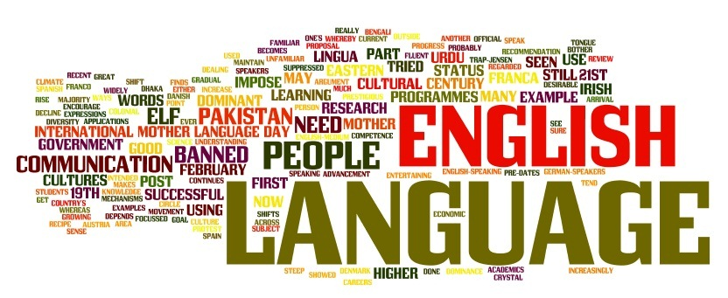
3. SPEAKING SKILL
1. Do you think people should do more to preserve endangered languages? Why or why not?
2. What do you think about learning English? How will it help you in the future?
3. Do you think learning English will threaten (hurt) your native language?

Slide 10
6. CONSOLIDATION
Cultures and languages
Agreeing and disagreeing opinions

Slide 11
7. HOMEWORK
How to preserve your native language?

Slide 12
THANK YOU!

