Slide 1
LEAD-IN

Slide 2
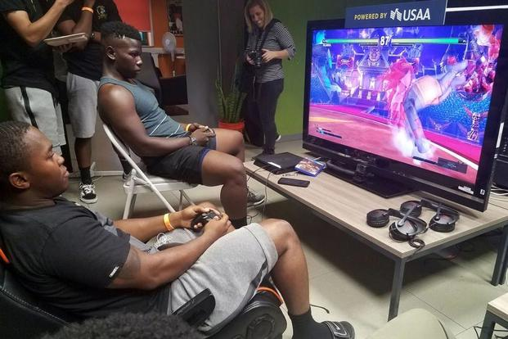
LEAD-IN
1. Look at the photo. What are the people doing?
2. Read the title of the unit. Do you think that video games can help us to improve our health? What are some negative effects of video games on our health?
3. Technology means new kinds of machines or ways of doing things using science and knowledge. What are some ways that technology can help us to stay healthy?

Slide 3
UNIT 7. HEALTH
MSc. DƯƠNG THỊ HỒNG PHÚC

Slide 4
Objectives
Knowledge:
- List vocabularies health and problems relating to health
- List expressions of giving advice
Skills:
- Improve language skills: speaking and listening,
- Express opinions
- Give and response to advice
- discuss how to keep fit and to have a good health.
Attitude:
- Be active, excited and enthusiastic in learning.
- Build a habit of using English in their careers.

Slide 5
1. VOCABULARY
1. needle | someone who spends a lot of time sitting, usually watching television
2. follow instructions | interest in and willingness to do something without needing to be told or forced to do it
3. treatment | a sickness
4. physical | create a solution that is temporary and won't solve a problem
5. connection | to talk about the problems or faults of someone or something
6. patient | something that is done to help someone who is injured or ill
7. motivation | having to do with our bodies
8. put a Band-Aid on | to do something in the way someone has told you to do it
9. couch potato | a very thin pointed steel tube that is pushed through the skin to put a drug into the body or to take blood out

Slide 6
2. CREATE
Work with two other students. Answer the questions. Give reasons for your opinions.
1. Do you think that video games are a good way to motivate patients? Why or why not? Did the administrator persuade you to agree with her?
What are some other ways to motivate people to take care of their health?
Do you like to play video games? What are some advantages and disadvantages of playing video games?

Slide 7
2. CREATE
1. What do you think is the best motivation to take care of your health? In other words, why should people want to take care of their health? How can doctors encourage their patients to be healthy?
2. Do you like to work out, either in a gym or at home? If not, do you do any other sports or activities to stay fit? Do you keep track of your progress?
3. Do you keep a regular sleep pattern, or do you sleep at different times during the week?
4. Do you use any traditional treatments or medicines to take care of your health? If so, what do you use?
5. Do you think there is a connection between your feelings and your physical health? Give an example.

Slide 8
3. SPEAKING SKILL
SHOULD / OUGHT TO / HAVE TO.
She should follow her doctor's instructions
Giving polite advice
What’s the matter?
You should call the doctor now
You should go to the doctor tomorrow
Ought to means the same as should
We ought to exercise more
Express concerns
Maybe you should ….change your sleep pattern
Maybe you ought to go to the doctor
You might want to get some rest
Why don’t you trying having some hot tea?
Have you tried exercising?
What’s wrong?
That’s too bad
I’m sorry to hear that

Slide 9
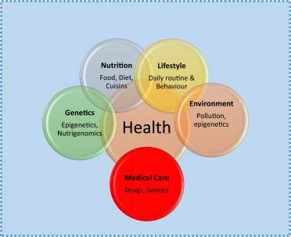
3. SPEAKING SKILL
What do you do to have a healthy life?/ have a good health?

Slide 10
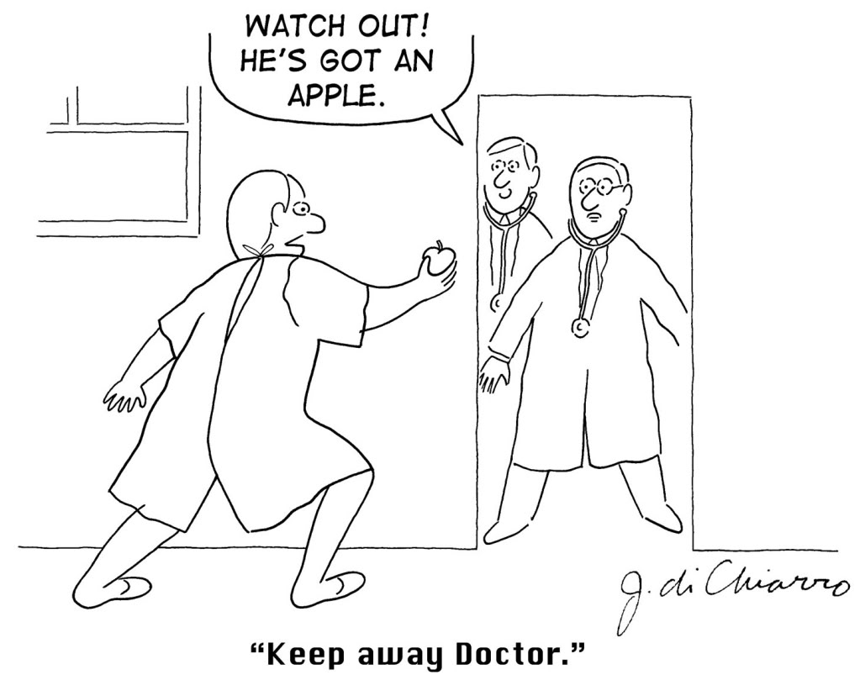
3. SPEAKING SKILL
"An apple a day keeps the doctor away."—Author unknown
"Every human being is the author of his own health or disease."—Siddhartha Gautama

Slide 11
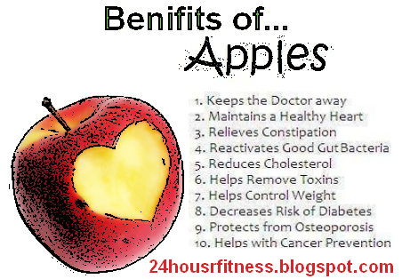
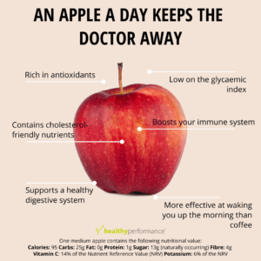
3. SPEAKING SKILL
"An apple a day keeps the doctor away."—Author unknown
"Every human being is the author of his own health or disease."—Siddhartha Gautama

Slide 12
6. CONSOLIDATION
Health and health problems
Express opinions and give advice
How to keep fit?

Slide 13
7. HOMEWORK
STEP l: Find out more about technology that can be used by doctors or ordinary people to help people lead healthier lives. Choose one topic from the list.
- Robots that operate on patients
- Video games that encourage people to take better care of their teeth
- Video games like Snow World that help patients manage their pain
- Virtual reality games that are used to train doctors
- Cell phone applications that encourage people to stop unhealthy behavior such as drinking too much alcohol, smoking, eating junk food, or not getting enough exercise

Slide 14
7. HOMEWORK
STEP 2: Research the topic on the Internet or in the library.
STEP 3: Share your information with the class. Include the following information:
- Who is the technology designed for?
- What does it do?
- How does it work?
- Is it effective? Are there any studies that show how well it works?

Slide 15
THANK YOU!
https://www.canstockphoto.com/stock-photo-images/health.html

