Slide 1
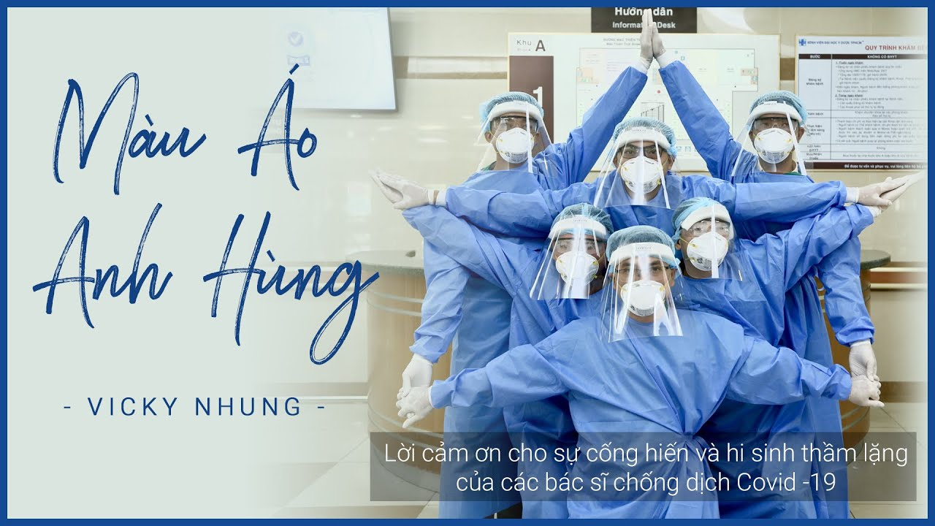
LEAD-IN
What do you think of the doctors?
What do people call them recently?
What does the word hero mean to you?
Can you think of any famous heroes? What do you think an “everyday hero” is?

Slide 2
UNIT 6 . HEROS
MSc. DƯƠNG THỊ HỒNG PHÚC

Slide 3
Objectives
Knowledge:
- Infer word meaning from context
- Categorize words with similar meanings
- Use signal phrases in presentations
Skills:
- Improve language skills: speaking and listening,
- Express opinions
- Ask follow-up questions
- Recognize and use signal phrases in presentations
- Give a presentation
Attitude:
- Be active, excited and enthusiastic in learning.
- Build a habit of using English in their careers.

Slide 4
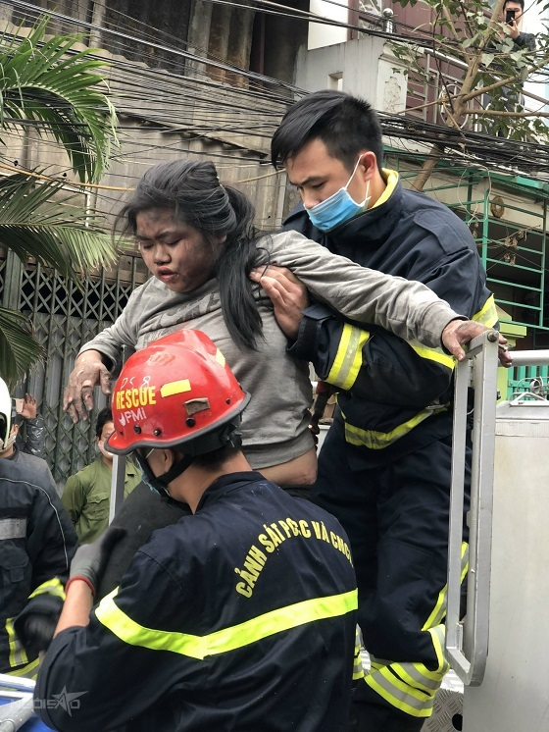
1. VOCABULARY
Community
Courage
Role-model
Praised
Reacted
Turned out
Generous
Do good deeds
Have a good heart
Make a difference

Slide 5
2. CREATE
Do you think it is a good idea for real-life superheroes to get involved in their communities to stop crime? Do you think they take too many risks?
Do you think we are responsible for caring for others in our community? Do you think one person can make a difference in other people’s lives? Why or Why not?
Do you volunteer in your community? If not, what kind of volunteer work do you think your community needs the most?
Name a person you know who is altruistic. Why do you think this person likes to help others? Give an example of something this person did that was generous or shows they have a good heart

Slide 6
2. CREATE
Name a person you know who has courage. Why do you think this person is brave?
Name a person you think is a good role model for others. What does this person do to inspire others?

Slide 7
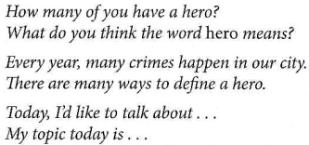
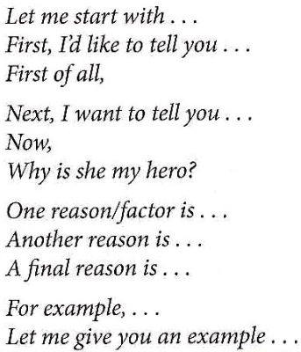
3. SPEAKING SKILL
Introducing your presentation
Making transitions
Concluding your presentation

Slide 8
3. SPEAKING SKILL
STEP 1: Think of a topic.
Think of someone that you admire. It can be someone you know, or it can be someone famous that you know about
STEP 2: Plan your presentation
Complete the chart by researching and taking notes about the person. Be sure to list at least three reasons you admire this person and include details and examples

Slide 9
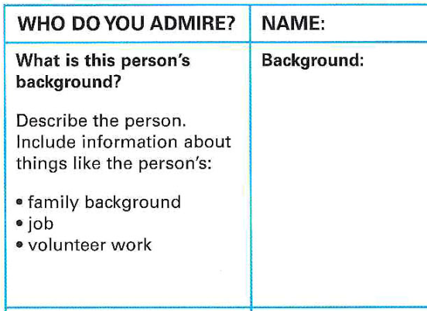
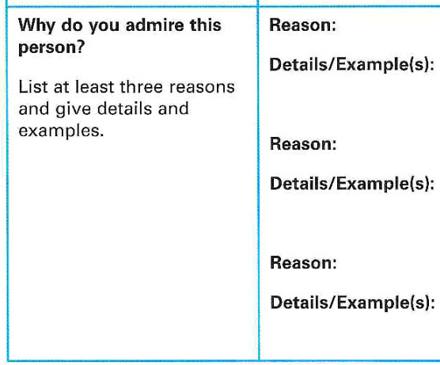
3. SPEAKING SKILL

Slide 10
5. ALTERNATIVE SPEAKING TOPICS
“You must be the change you want to see the world” (Mahatma Gandhi)
“From what we get in life, we make a living. From what we give, we make a life” (Arthur Ashe)
“The world is a dangerous place, not because of those who do bad things, but because of those who look on and do nothing.” (Albert Einstein)
“Work for something because it is good, not just because it stands a chance to succeed.” (Vaclav Havel)
“And the trouble is, if you don’t risk anything, you risk even more.” (Erica Jong)
“I’d rather die for speaking out than to live and be silent.” (Confucius)

Slide 11
6. CONSOLIDATION
- Infer word meaning from context
- Categorize words with similar meanings
- Use signal phrases in presentations
- Express opinions
- Ask follow-up questions

Slide 12
7. HOMEWORK
Go on the Internet or ask people in your community to find an organization that is trying to solve this problem.
1. What is the name of the organization?
2. How many people volunteer or work for this organization?
3. What do they volunteers do to help others? Give examples
4. Would you like to join this group? Why or why not?

Slide 13
THANK YOU!

