Slide 1
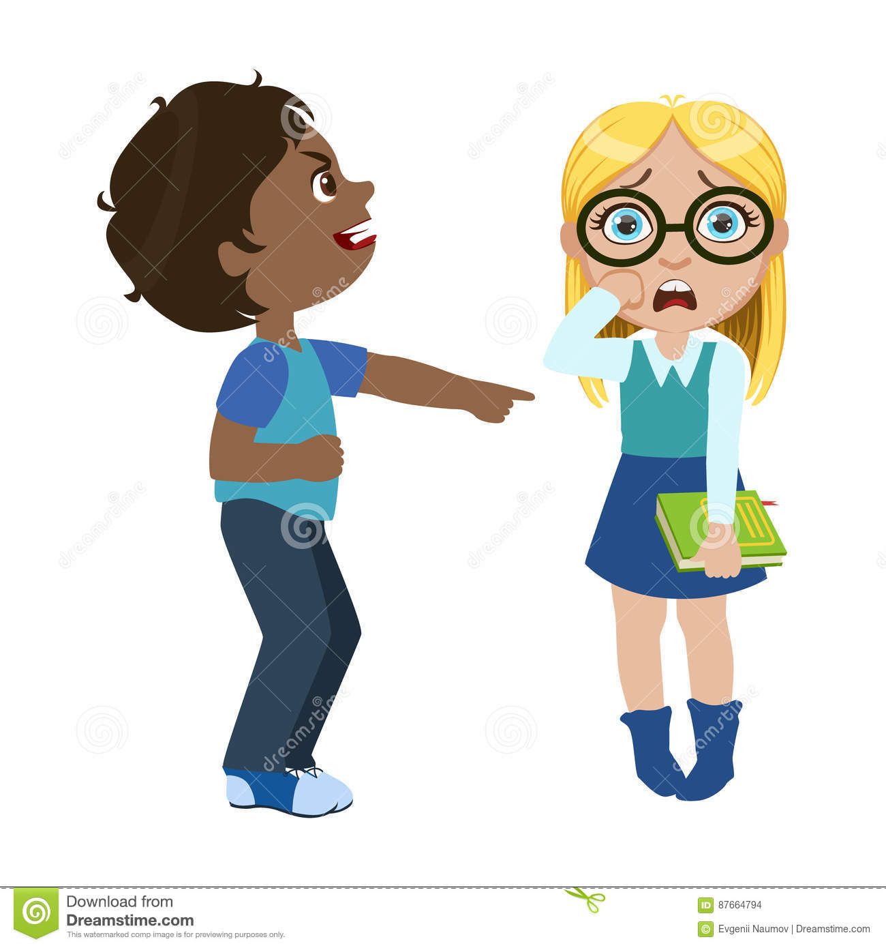
LEAD-IN
1. Look at the picture. What’s happening?
2. In your opinion, is this polite or not? Why do you think so?
3. Etiquette the rules we follow to behave (act) politely. What are some other actions that you think are polite? What are some that are rude (not polite)? Why do you think they are rude? Discuss your opinions with the class.

Slide 2
UNIT 4. MANNER
MSc. DƯƠNG THỊ HỒNG PHÚC

Slide 3
Objectives
Knowledge:
- List vocabularies relating to manner and etiquettes
- List expressions of opinions and polite expressions
Skills:
- Improve language skills: speaking and listening,
- Express opinions
- Summarize key information
- Support reasons with examples
- Make and respond to requests and invitations
Attitude:
- Be active, excited and enthusiastic in learning.
- Build a habit of using English in their careers.

Slide 4
1. VOCABULARY
Match the phrase on the left with its meaning on the right.
1. go out | a.to cancel or delay an event; to decide that an event will not happen
2. leave someone hanging | b. a situation that is bad, annoying, or disappointing
3. look forward to | c.to tell someone that you can't do something with them now, but you would like to do it at another time
4. call something off | d.I can't accept your invitation.
5. blow off | e.to ignore someone
6. turn down | f.to say "no" to an invitation
7. bummer | g.go on a date; to have a romantic relationship
8. I'll have to pass | h.to be excited and pleased about something that is going to happen
9. take a rain check | to keep someone waiting for a decision or answer

Slide 5
2. CREATE
Work in groups of four. You will have a debate about each of the actions listed below. For each action, each student will take a side—either you think it is courteous or rude.
Actions
Taking your shoes off before entering someone's home
Talking on your cell phone while in a restaurant with friends
Not responding to an Invitation
Texting while having a conversation with someone
Throwing garbage on the ground (littering)

Slide 6
2. CREATE
A: I think taking your shoes off before entering someone's house is very courteous. It shows respect for the other person. I really appreciate it when people take their shoes off when they come to my house. Plus, it helps to keep my house clean
B: Really? I don't think it's courteous to take them off. I wasn't raised to do that, so I don't think it of manners to leave them on

Slide 7
3. SPEAKING SKILL
MAKING POLITE OFFERS AND INVITATIONS
ACCEPTING AND DECLINING
Yes, I would
CAN, COULD AND WOULD IN POLITE REQUESTS
Would you like something to drink?
Can you do me favor?
Would you help me with the dishes?
Could you hold the door for me?
Yes, thank you
Yes, please.
Thanks, I appreciate it
I’d love to
Sure, that sounds great
Sorry, but I have to study tonight.

Slide 8
3. SPEAKING SKILL
STEP1: Read each situation aloud in your group. Discuss the situations. What could you say?
You are in a restaurant having dinner with a friend. A person is sitting alone at a table near you, talking loudly on a cell phone. You can't hear your friend or enjoy your meal.
You are at a party with your friend. Another person comes over and enters the conversation and makes small talk with you. Your friend gets bored and starts texting.

Slide 9
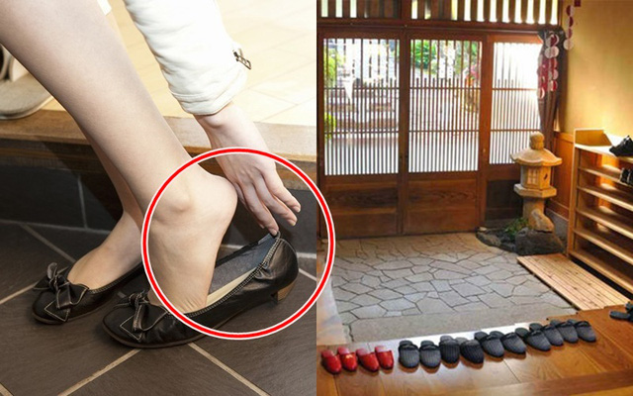
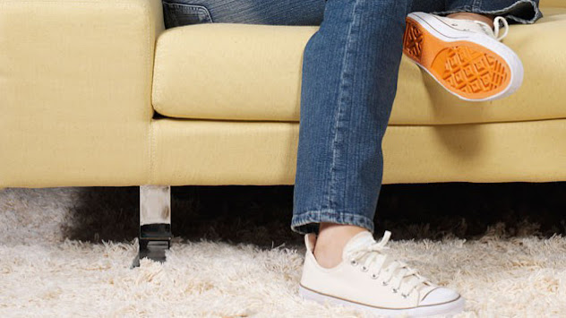
3. SPEAKING SKILL
You go to your friend's house for dinner. Your friend is from another culture. When you enter, you forget to take off your shoes. Then, during dinner, your friend's mother offers you different kinds of food that you never tried before. There is one kind of food that you don't like, but your friend's mother keeps offering it to you.
STEP 2: Choose one situation and prepare a role play.
STEP 3: Role-play your situation for the class.

Slide 10
5. ALTERNATIVE SPEAKING TOPICS
In your opinion, are people less polite these days than in the past? Give examples to explain your opinion.
Where did you learn manners: At home? At school? At a religious institution?
New York City scored as the number one city for good manners. Are you surprised? Why or why not?
How do you think people in your hometown would do on Sarah's manners test? Do you think they would pass? Why or why not?

Slide 11
6. CONSOLIDATION
Manner and etiquette
Making polite offers and invitations
Accepting and declining

Slide 12
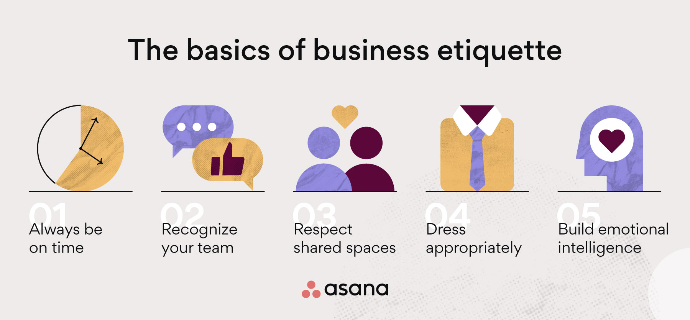
7. HOMEWORK
Write etiquette for your office/ your class

Slide 13
THANK YOU!

