Slide 1
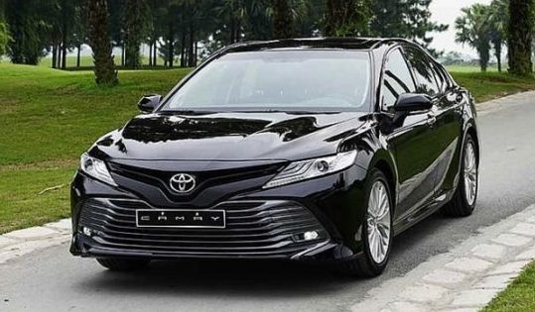
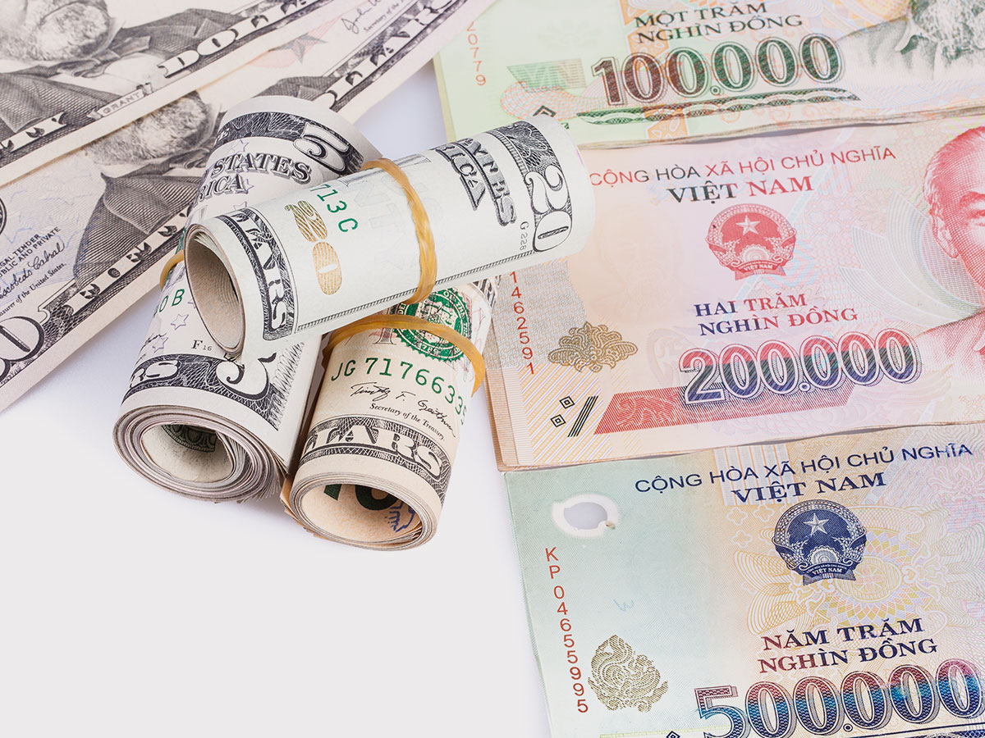
LEAD-IN
The couple want the car but he doesn’t have enough money. What do you think he should do?
2. How do you pay for the things you need? (cash, credit cards, loans?) Do you think it is the best way to pay for things when you want to save money? Why do you think so?
3. What do you think about the saying: a penny is saved is a penny earned?

Slide 2
UNIT 3. SAVING MONEY
MSc. DƯƠNG THỊ HỒNG PHÚC

Slide 3
Objectives
Knowledge:
- List some popular currencies
- List some products and services that are necessary for daily life
- List vocabularies relating money
- Expressions of agreement and disagreement
Skills:
- Improve language skills: speaking and listening,
- Express agreement and disagreement
- Compare products and services
- Negotiate for goods and services
Attitude:
- Be active, excited and enthusiastic in learning.
- Build a habit of using English in their careers.

Slide 4
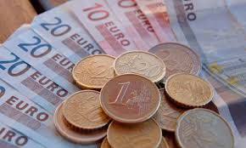
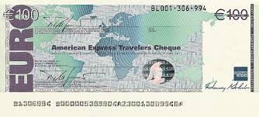
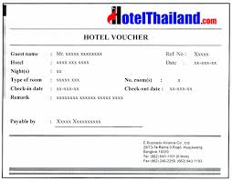
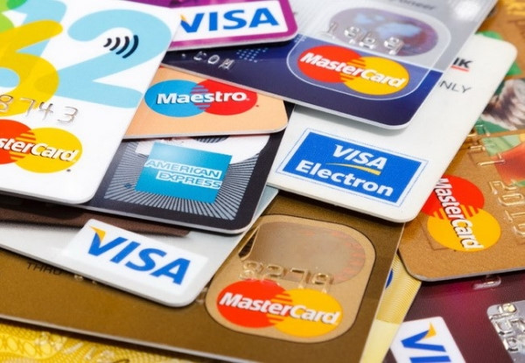
VOCABULARY
Match these words with the pictures as follow:
- (By) credit card (VISA, Master card, JCB, American express)
- (With) traveller’s cheques
- (With) a voucher (from a tour operator or travel agent)
- (In) cash (Bank note, coins)

Slide 5
1. VOCABULARY
Complete the sentences with the words in the box
Cash, Bill, Change, Receipt, Deposit, Insurance, Credit card, Commission, Traveller’s cheque Exchange rate
The ... is extra money that you pay for a service.
A ... is a piece of paper that shows how much you must pay.
A ... is a sum of money which is the first payment for something.
... is money in the form of notes or coins.
... is money you pay to protect yourself against something bad happening.
A ... is a piece of paper that shows how much you have paid.
A ... is a cheque you can exchange for foreign money.
A ... is a plastic card you can use to pay for things.
.... is the money you get back if you pay more than something costs.
The.... is the value of one currency compared to another

Slide 6
2. CREATE
Work in a small group. Take turns asking and answering the questions.
. Do you like to bargain with sellers when you shop? Do you bargain when you buy from street vendors? Why or why not?
Do you like to buy things used? Why or why not? If yes, what are some things that you like to buy used? What are some things you never buy used?
Name a store or place to shop that you think has good bargains. What kinds of bargains can you get there?

Slide 7
2. CREATE
Name something you bought that you got a good deal on. Where did you get it? Why do you think it was a good deal?
Do you have a lot of stuff in your house? What do you usually do with stuff that you don't use anymore—do you prefer to keep it, throw it away, or give it to someone else?
Name something you own that was cheap to buy. How much did it cost? Name something that you paid an arm and a leg for.
Do you own something that is worth more now than when you bought it? How much did you spend on it? Was it worth it?

Slide 8
3. SPEAKING SKILL
Agreeing with suggestions
Disagreeing with suggestions:
Making suggestions:
Ok/all right
Let’s buy this chair
Why don’t we go to the thrift store?
How about buying a used car instead of a new one?
That’s fine with me
That’s a good idea
Let’s do it
It’s a deal
Ok. Why not?
Well, I don’t know. How about ….?
I have another idea. Why don’t we …?
I don’t think so.

Slide 9
3. SPEAKING SKILL
Work in a small group. Take turns suggesting things to buy. When everyone agrees, write your group's list below.
Example
A: Let's buy the used couch for $100.
B: Well, I don't know. I don't want a used couch. How about buying the new one?
C: But it costs a lot. Why don't we buy the chair?
Your Group's List …………

Slide 10
4. FINAL SPEAKING TASK
In this activity, you will practice bartering for goods and services with your classmates
STEP l: Get five blank cards. On four of the cards write the following:
name of an item you would like to exchange (and a drawing, if you'd like)
- how old it is
- how much money you think it is worth now

Slide 11
4. FINAL SPEAKING TASK
STEP 2
Go around the class and barter with your classmates. Compare your items and services and negotiate with each other until you come to an agreement. When you come to an agreement, trade your cards.
Example
A: How about exchanging your television for my computer?
B: But my television is newer than your computer.
A: Yeah, but my computer is more valuable.
B: Thanks, but that's not worth it. I want to keep looking.
OR
B: OK. It's a deal.

Slide 12
4. FINAL SPEAKING TASK
STEP 3: Report your exchanges to the class.
Example
A: I traded a two-year-old television worth $300 for a three-year-old computer worth $350.
B: That's a pretty good deal.
C: Well, I paid an arm and a leg for a TV.
STEP 3

Slide 13
5. ALTERNATIVE SPEAKING TOPICS
Do you think that most people have too much stuff? Why or why not? Give examples.
Do you think the Compact is a good idea or a bad idea? Why? Could you keep a promise not to buy anything new for a year? Explain.
Do people in your culture buy and sell used stuff? If yes, where? If no, why not?
What kinds of things do you only want to buy new? What will you buy used? Why will you buy some things used but others new?

Slide 14
6. CONSOLIDATION
Money and saving money
Bargaining
Making suggestions
Agreeing and disagreeing with suggestions

Slide 15
7. HOMEWORK
Think of something you would like to buy, such as a camera, a cell phone or other electronic device, or a jacket. Then go to a store or use the Internet to compare two different kinds. Compare the item and price. You may want to read some reviews to see what other people think of it. Answer the questions about your choice. If the question doesn't apply, write N/A (not applicable). Take notes and write the information in the chart below.
STEP 2: Report back to the class, telling which item you would like to buy and why.

Slide 16
7. HOMEWORK
 | ITEM 1 | ITEM 2
HOW MUCH DOES IT COST?
WHAT DOES IT LOOK LIKE?
WHAT CAN IT DO?
HOW WELL IS IT MADE?
HOW BIG IS IT?
DO YOU WANT TO BUY IT?
WHY OR WHY NOT?

Slide 17
THANK YOU!

