Slide 1
LEAD-IN
Which of these activities do you think the student is doing:
Doing school work,
listening to music,
texting (sending a written message by phone),
chatting online (having a conversation),
surfing the Web (looking at different Internet sites),
watching videos,
playing video games?
Do you ever do any of these activities at the same time? Which ones?

Slide 2
UNIT 2. STUDENT LIFE
MSc. DUONG THI HONG PHUC

Slide 3
Objectives
Knowledge:
- List some words relating to student life and study
- List vocabularies daily routine
- Expressions of agreement and disagreement
Skills:
- Improve language skills: speaking and listening,
- Express agreement and disagreement
- Compare life styles
- Deal with problems
Attitude:
- Be active, excited and enthusiastic in learning.
- Build a habit of using English in their careers.

Slide 4
1. VOCABULARY
Match the phrases on the left with the meanings on the right
1. hit the books | a. to stay up all night working on something
2. ace | b. the last possible time that something can be done
3. cut class | c. to study
4. hang out | d. to understand or solve by thinking
5. Fall behind | e. to receive a grade of 'A" or to complete something easily and successfully
6. The last minute | f. to fail to do something as quickly as planned or as required
7. Pull an all-nighter | g. to quickly prepare right before a test
8. Bomb | h. to skip a class or day of school without an excuse
9. Figure out | i. to fail a test
10. Cram | j. to spend time in a certain place or with people

Slide 5
2. CREATE
Work in a small group. Take turns asking and answering the questions.
Situation 1: You are roommates in college.
Student A, you have a big test tomorrow and want to study. You're nervous.
Student B, you want to have a party, but your roommate disagrees. You're upset with your roommate.
Situation 2: You are a student and a counselor.
Student A, you need some help managing your time and learning better study habits. You ask the counselor for some help.
Situation 3: You are a student and a parent talking about school.
Student A, you are not doing very well in school. Your parent wants you to explain why.
Situation 4: You are a student and a professor discussing an assignment that is due.
Student A, you ask your professor for more time to finish the assignment. Your professor wants you to turn it in on time.

Slide 6
3. SPEAKING SKILL
EXPRESSING AGREEMENT AND DISAGREEMENT
Strong agreement
I totally agree
Weak agreement
Maybe
Strong disagreement
I totally disagree
Weak disagreement
I agree (with you/Sheila/Tom)
I think so, too.
I'm with you.
That’s true
I guess so
I disagree
I don't think so.
I'm not sure about that.
I don't know
Maybe, but don't you think ?
Actually, I think …

Slide 7
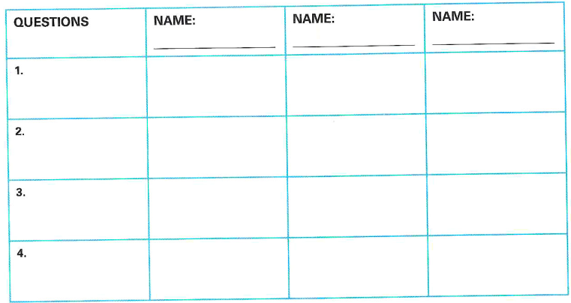
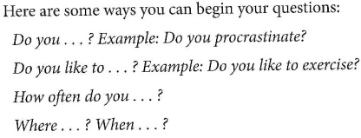
4. FINAL SPEAKING TASK
STEP 1

Slide 8
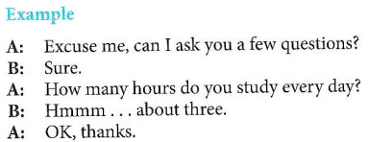
4. FINAL SPEAKING TASK
STEP 2
Each person should speak to at least three different students in the class. Write each student's name in the chart. Write down their responses.

Slide 9
5. ALTERNATIVE SPEAKING TOPICS
Do you think it's better for students to live at home with their families, or away from home?
Do you prefer a large school or a small school? Why?
What do you think is the most important factor in student success?
Who do you ask for advice when you face challenges?

Slide 10
6. CONSOLIDATION
Students and study
Student life
Agreeing and disagreeing opinions

Slide 11
7. HOMEWORK
STEP l: Work in small groups. Think of some challenges you have as a student. For example, maybe you have trouble remembering information for tests, or you need to manage your time better. Each of you should choose a different challenge you want to learn how to manage
STEP 2: Now, work alone. Go to the library, look on the Internet, or interview someone who is an excellent student to learn about a strategy that can help you to deal with this challenge. Take notes. Your notes should include this information
STEP 3: Report your information to the class.

Slide 12
THANK YOU!
MSc. DUONG THI HONG PHUC

